Slide 1
INTERNAL COMB ENGS
TOPICS TO STUDY
-ENGINE COMPONENTS
-SCAVENGING AND SUPERCHARGING
-FOURSTROKE ENGINES
- TWO STROKE ENGINES
-EXHAUST SYSTEMS
-DIESEL ENGINE CONTROL
-MULTI ENGINE PROPULSION ARRANGEMENT
-FUEL INJECTION
-STARTING AND REVERSING

Slide 2
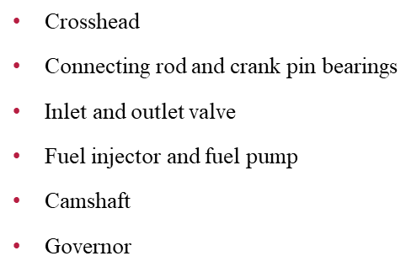
ENGINE COMPONENTS
Bedplate
A-Frame
Entablature
Holding down bolts(tie bolts)
Crankshaft
Cylinder and Cylinder liner , Cylinder lubrication
Piston and piston rings

Slide 3
BEDPLATE
Main strength member, supports weight of other engine components.
Provides rigid support for main bearings and crankshaft.
Support the static load of stationary engine frame.
Capable of withstanding fluctuating forces created during operation of the engine.
Distribute static and dynamic load generated by running engine onto ship structure or hull.
Collect the crankcase lube oil and transfer it to the sump tank from where the lube oil pump can take suction.
Fasten engine to the tank top transmitting propeller thrust

Slide 4
TYPES OF BEDPLATE
TYPES
Two types: Box type bedplate and Trestle type bedplate
Box-type bedplate – Flat bottom which allows it to be bolted to ship's flat tank top
Trestle type bedplate-Sits upon two parallel raised portions of ship's structure located at the fore and aft direction.

Slide 5
CONTRUCTION OF BEDPLATE
Longitudinal girders and transverse girders
Two longitudinal girders which run the length of the engine.
Connecting to the two longitudinal girders are the transverse girders which are positioned between each crankshaft throw.
Built into transverse girders are main bearing pockets for crankshaft to run in.
Made of cast iron as single casting, while larger engines have bedplates made of fabricated steel i.e: steel sections, steel castings and plates welded together.

Slide 6
A-FRAME AND ENTABLATURE
A-FRAME: Supports crosshead guides and supports engine entablature
An entablature is a part of the ship’s main engine. It is the housing which holds the cylinder liner, along with the scavenge air space and cooling water spaces. The entablature is usually made of cast iron.
Fitted bolts are used to align and bolt the “A” frame to the entablature. It is to note that the “fitted bolts” that are used to bolt entablature, A” frames and bedplate together are only for alignment purpose and not to resist stresses generated as a result of firing forces. This work is done by tie rods.

Slide 7
TIE RODS/TIE BOLTS
Tie rod is a long strong rod with bolts or tie bolts at both the end. This rod holds the three major engine components i.e. Cylinder block or entablature, “A” frame, and crankcase in compression and transmits the firing load to the bedplate.
The tie rods are fitted through the above mentioned components and are hydraulically tightened so that the whole engine can be held in compression.

Slide 8
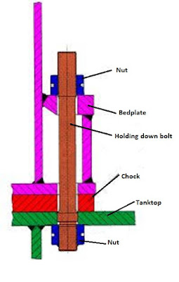
HOLDING DOWN BOLTS
Supported on a series of chocks.
Strengthens stiffness of engine.
Provides a clamping force.

Slide 9
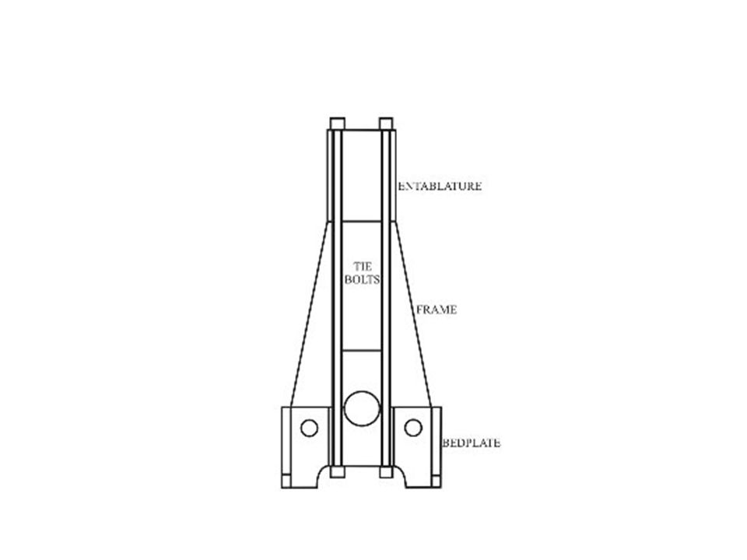

Slide 10
